Slide 1
Salesforce management poses a unique set of challenges in emerging markets
BASIC MATERIAL | ASIA
BAS027
Unit of measure
1
Several thousand retail outlets spread across hundreds of micro-market; low level of standardization and automation across regions
2
Mindset of ‘salesforce is a cost’, rather than treating it as an investment
3
Cookie cutter approach of directly transporting tools from developed markets. Such tools are over-configured, expensive and require long deployment time in emerging markets
4
Inadequate investment in developing and using analytics engine to drive decision making
5
Performance management discussions focused on symptoms i.e. output metrics, limited attention to diagnosing root-causes
6
Outdated classroom based capability building for sales people run by HR

Slide 2
Our experience suggests that debottlenecking salesforce productivity can drive 20-30% growth over baseline in 6-9 months in emerging markets
Description of impact
Cement
20% increase in salesforce productivity within 3 months of implementation launch driven by
35% increase in #visits to retailers
40% increase in #planned visits
71% increase in #unique retailers covered
Consumer durables
3X increase in the average productivity of the salesman in 12 months
1.4X increase in efforts (Number of consumer interactions and demos)
1.8X increase in average order size per consumer
1.3 X increase in conversion ratio (Conversion / meetings)
Pharmaceuticals
5-7% difference in sales target achievement between top quartile and bottom quartile scorers on the Ninja microlearning platform by
91%+ adoption of the learning application
60 mins+ per week spent on Ninja learning, more than their social media time and more than twice their pre Ninja learning time
Automotive
40%+ improvement in overall sales conversion
5x increase in proportion of high priority leads
50% increase in timely follow-up of high priority leads
70% increase in test-drives with high priority leads

Slide 3

Salesforce of the future: from ‘Road Warrior’ to ‘Customer Expert’
Unit of measure
From road warrior
To customer expert
1
Covers an assigned geographical territory
Owns micro-markets with estimated potential; irrespective of geographical size
2
Unstructured sales planning and manual recording of market inputs
End to end sales planning and structured gathering of market intelligence, manages self-performance supported through digital platforms
Regular interaction through calls/ meetings with marketing/ sales managers on output metrics; annual review with HR
Realtime self-performance management with full transparency on input metrics
3
Judgement-based customer prioritization and associated pitch, decision making
Powered by virtual assistants, analytics-based inputs for customer prioritisation and decision making
4
One time, 3+ weeks/year of classroom training with very limited reinforcement
Digital micro-learning with “on the go” gamified learning modules, with adoption enabled by mobile-first approach

Slide 4


Overall context at a leading steel player in India and ingoing consideration for using a digital sales force solution
Case example 2. DIGITAL TOOLS
2
Client context
Ingoing considerations for digital
Market ready products 7X of allocated budget
New direct selling channel created by recruiting 150+ sales executives on the payroll of distributors
Need to train salesforce and ramp-up productivity quickly within 3 months
Need for a simple lead-management tool that can be installed directly on a smartphone and can work off-line
Simple, configurable features and cost effective development
Quick to market – deployed in 2-3 weeks
Ability of the app to work offline and therefore, can be used in areas with poor internet connectivity
Easy, intuitive and eliminated excel based reporting – less than 5% reporting time

Slide 5

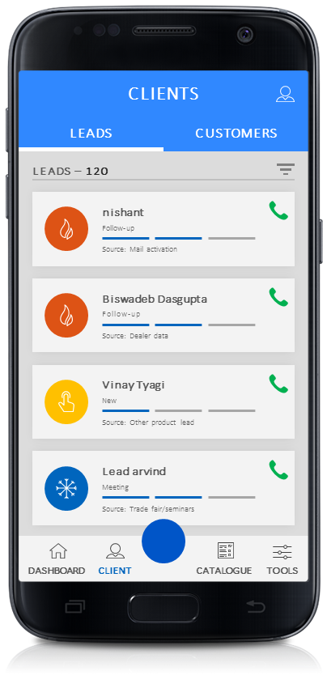
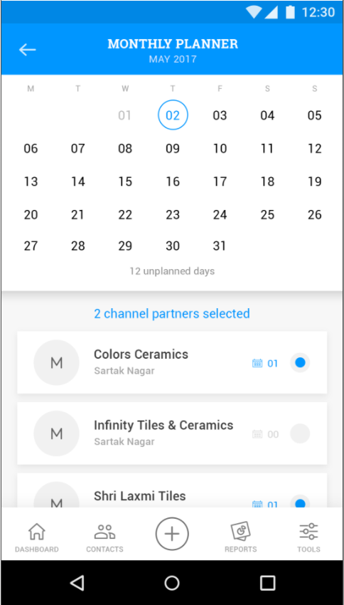
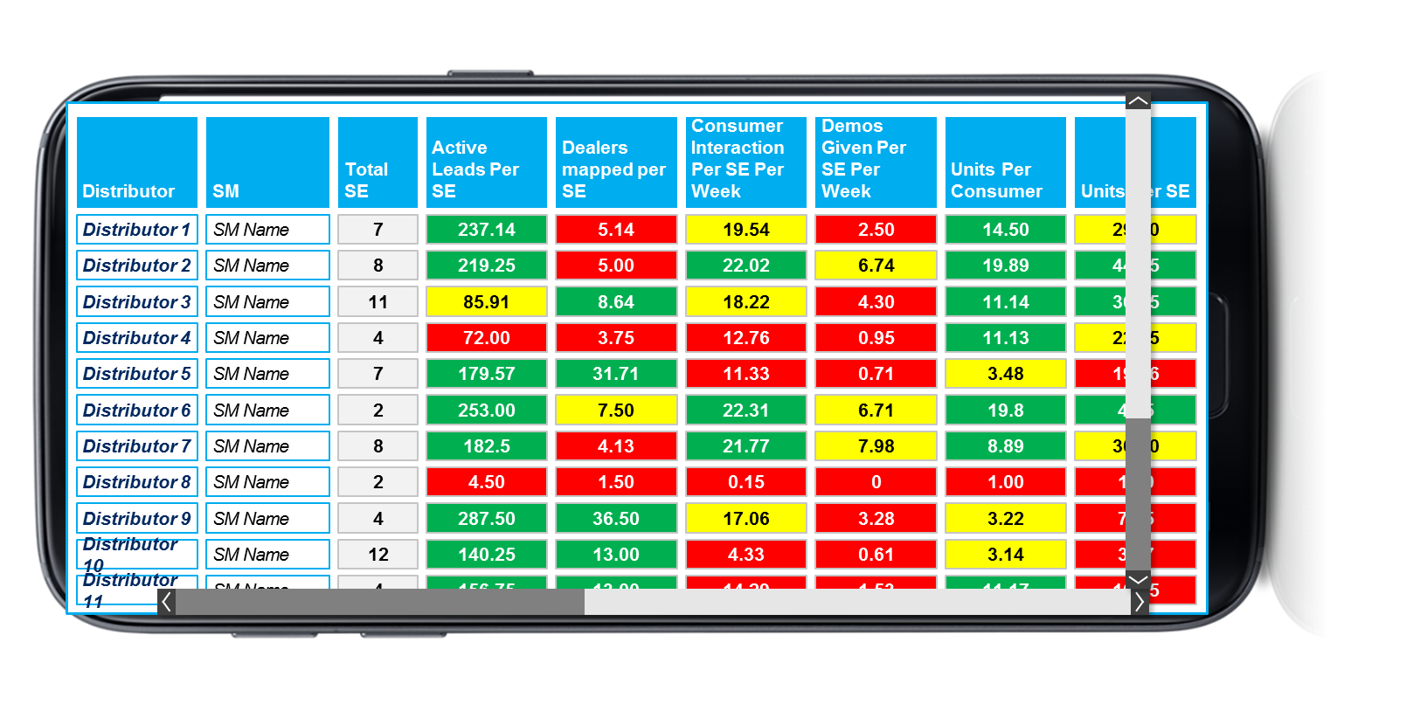
What we did: Developed a real time digital solution to aid salesforce effort on ground and real time performance management
Case example 2. DIGITAL TOOLS
2
Tailoring approach and effort based on lead prioritisation (hot / warm / cold)
Journey cycle planning made easier -dashboard view of plan for the day, reminders through in-app alerts on next steps, and more
A
C
End to end lead management enabled - tracking past activity, scheduling meetings / demos, booking orders, and more
B
What is causing drop from first interaction to demo?
D
E
Is the executive following up on scheduled interactions?

Slide 6
Impact we had: 5x increase in sales in 8 months
Case example 2. DIGITAL TOOLS
2
Program started
Growth of retail sales in 6 months
Bookings normalized
+66%
+29%
Q2
Q3
Q4
Q5
Q6

